Slide 1
Refutation = Rebutt
Meleg András
25/02/2019
Corvinus & ELTE Debate Club

Slide 2
Contents
0) Revision
1) Why is it important?
2) Rules of thumb: „Do”s and „Don’t”s
3) Some forms of rebuttal
4) Practice
5) Observations of practice and further advice
6) Wrap-up
7) Motion + Debate

Slide 3

0) Revision
The SEXY model...
Deduction
Induction
Analogy
Abduction

Slide 4
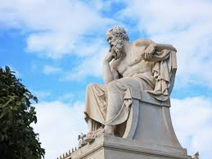
1) Why is it important?
„He is a man of courage who does not run away, but remains at his post and fights against the enemy.”

Slide 5
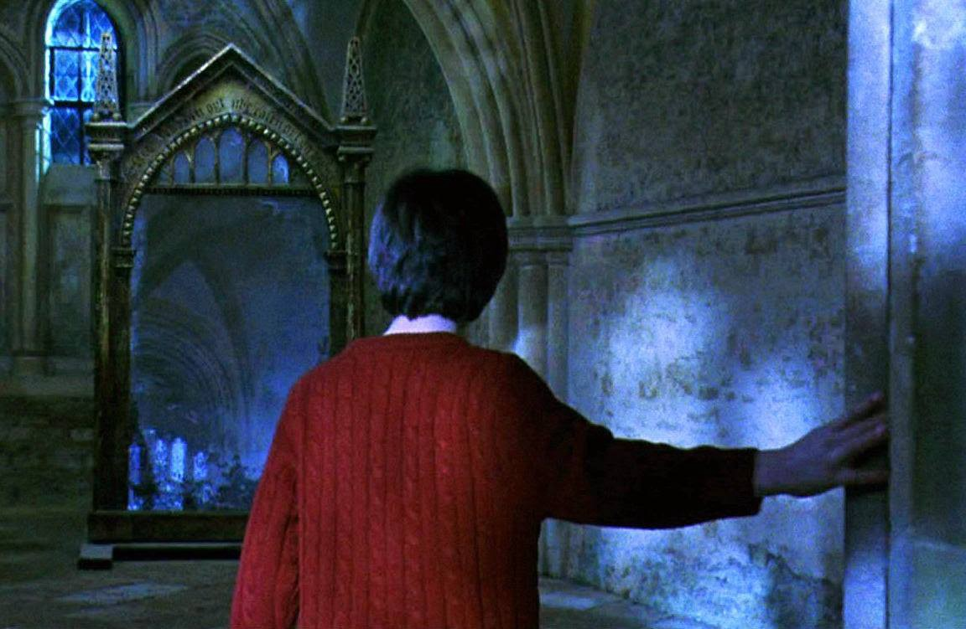
2) Rules of thumb: „Do”s and „Don’t”s
DO
DON’T
Start with rebuttal
Attack your opponent’s most important ideas at their strongest
Complete the attack
Prioritize new arguments
Rebut every single thing
Do one-liners
Ask rhetorical questions

Slide 6
3) Some forms of rebuttal
Attacking relevance
Attacking assumption
Attacking the impact
Attacking a leap in logic
Attacking examples

Slide 7

Attacking relevance
„We respect and support China's rights to take counter-terrorism and de-extremism measures to safeguard national security. We stand ready to strengthen cooperation with China," Mohamad Bin Salman, 2019
REBUTT: Bin Salman is a leader of a muslim country, where terrorism is not a factor, and it should be much more important, to talk about the issues of muslim minorities in China, and how they are treated. This keeps sending out a bad message...

Slide 8
Attacking relevance
„So, as a conclusion, this proposition would boost Nigeria’s GDP, by increasing industrial output.”
REBUTT: Industrical factories are held by global corporations, and they are not intended to spend their profit in Nigeria. Thus, the average nigerians won’t earn more money, and it is likely that this proposal won’t help them, meanwhile, foreign capital investors already have a good enough life.

Slide 9

Attacking the impact
"The heartbreaking violence in Venezuela must stop. I stand with President @JGuaido, the National Assembly, and the people of #Venezuela as they embrace their right to live in peace, choose their leaders, and decide their future, in harmony with their neighbors.„ Hillary Clinton on Twitter
REBUTT: Peace and democracy are marginal short-term impacts, compared to the economic problems, that Venezuela is currently facing. It doesn’t matter, how long the civil war keeps going, but the ultimate goal mustn’t be peace or democracy itself, but to establish a sustainable economy, therefore noone should intervene in the Columbian conflict, because solving the crisis from foreign aid, will force Venezuela to a less souverign, and less sustainable economy in the future.

Slide 10
Attacking the impact
„...and providing universal basic income, will release stress for the unemployed, therefore, they will have an easier time to reintegrate to the labour-market.”
REBUTT: Releasing stress will decrease the motivation for the unemployed to seek jobs. Therefore, we must set up minimal conditions for welfares, such as participation in public-service works, or actively searching for a job, fitting to their qualifications.

Slide 11

Attacking a leap in logic
„I would build a great wall, and nobody builds walls better than me, believe me, and I’ll build them very inexpensively. I will build a great great wall on our southern border and I’ll have Mexico pay for that wall.”
REBUTT: „even if” the wall would bring advantages, there is no logical connection that Mexico is going to pay for it, since it is a separate souverign country, which would not be a benefactor of that wall. Therefore, it is safe to assume that Mexico will not pay for the wall, unless the opposition explains, why will Mexico pay for it.
NOTICE: 2nd speaker of the other team can react for this rebuttal
NOTICE: your 2nd speaker can react for their rebuttal, in any case...

Slide 12
Attacking a leap in logic
„These (gipsy) children should play football together with the others, and be the best there. Because if we have had made a gipsy thingy, we would get state fundings. We’d have a lot of money [...] but we couldn’t develop the children as far, as an integrated program could. So hellyeah integrated football academies!” 444.hu: Miért van kevés roma a magyar fociban?
REBUTT: 1) If we could get money, children could be developed playing good football.
2) We don’t have to put out roma children for rascism, thus we don’t necessary need integrated football academies anyways.

Slide 13

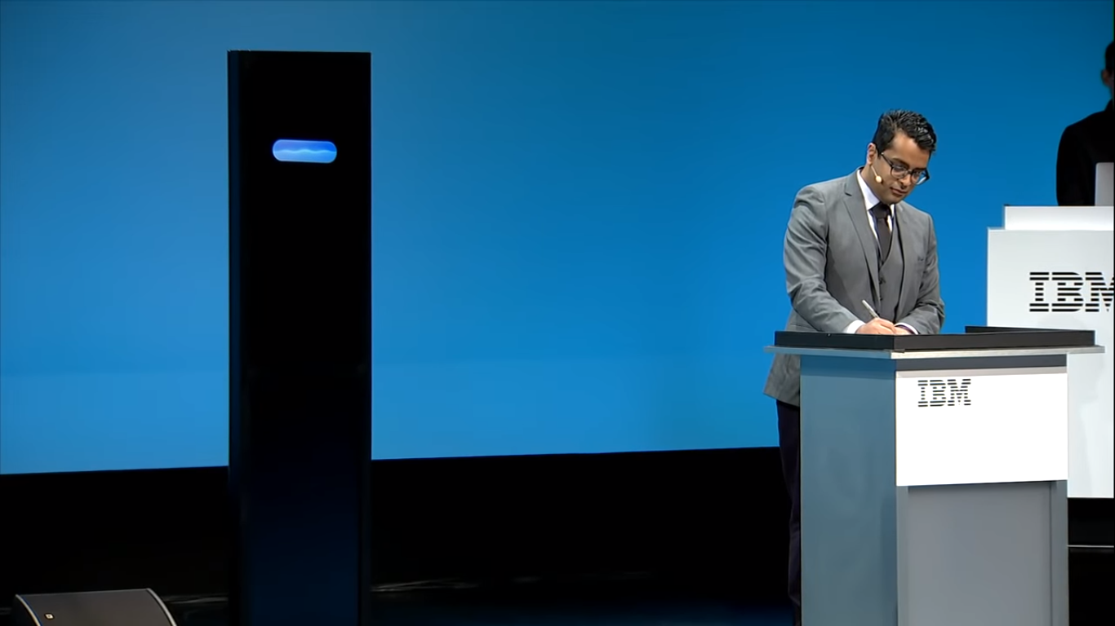
Attacking examples
NO EXAMPLE TENNIS PLEASE!
ATTACK THE QUALITY in the example.

Slide 14
Attacking examples
Come up with something

Slide 15
Attacking examples
On the spot...

Slide 16
4) Practice
A) THW take lifestyle choices into consideration in the allocation of medical resources
B) This House Would introduce a 100% inheritance tax

Slide 17
5) Observations of practice and further advice

Slide 18
5) Observations of practice and further advice
Probably you won’t look up the theoretics of refutation.
The most important thing is to react for the claims of the other side!
No definite truth and answer in Debateland.

Slide 19
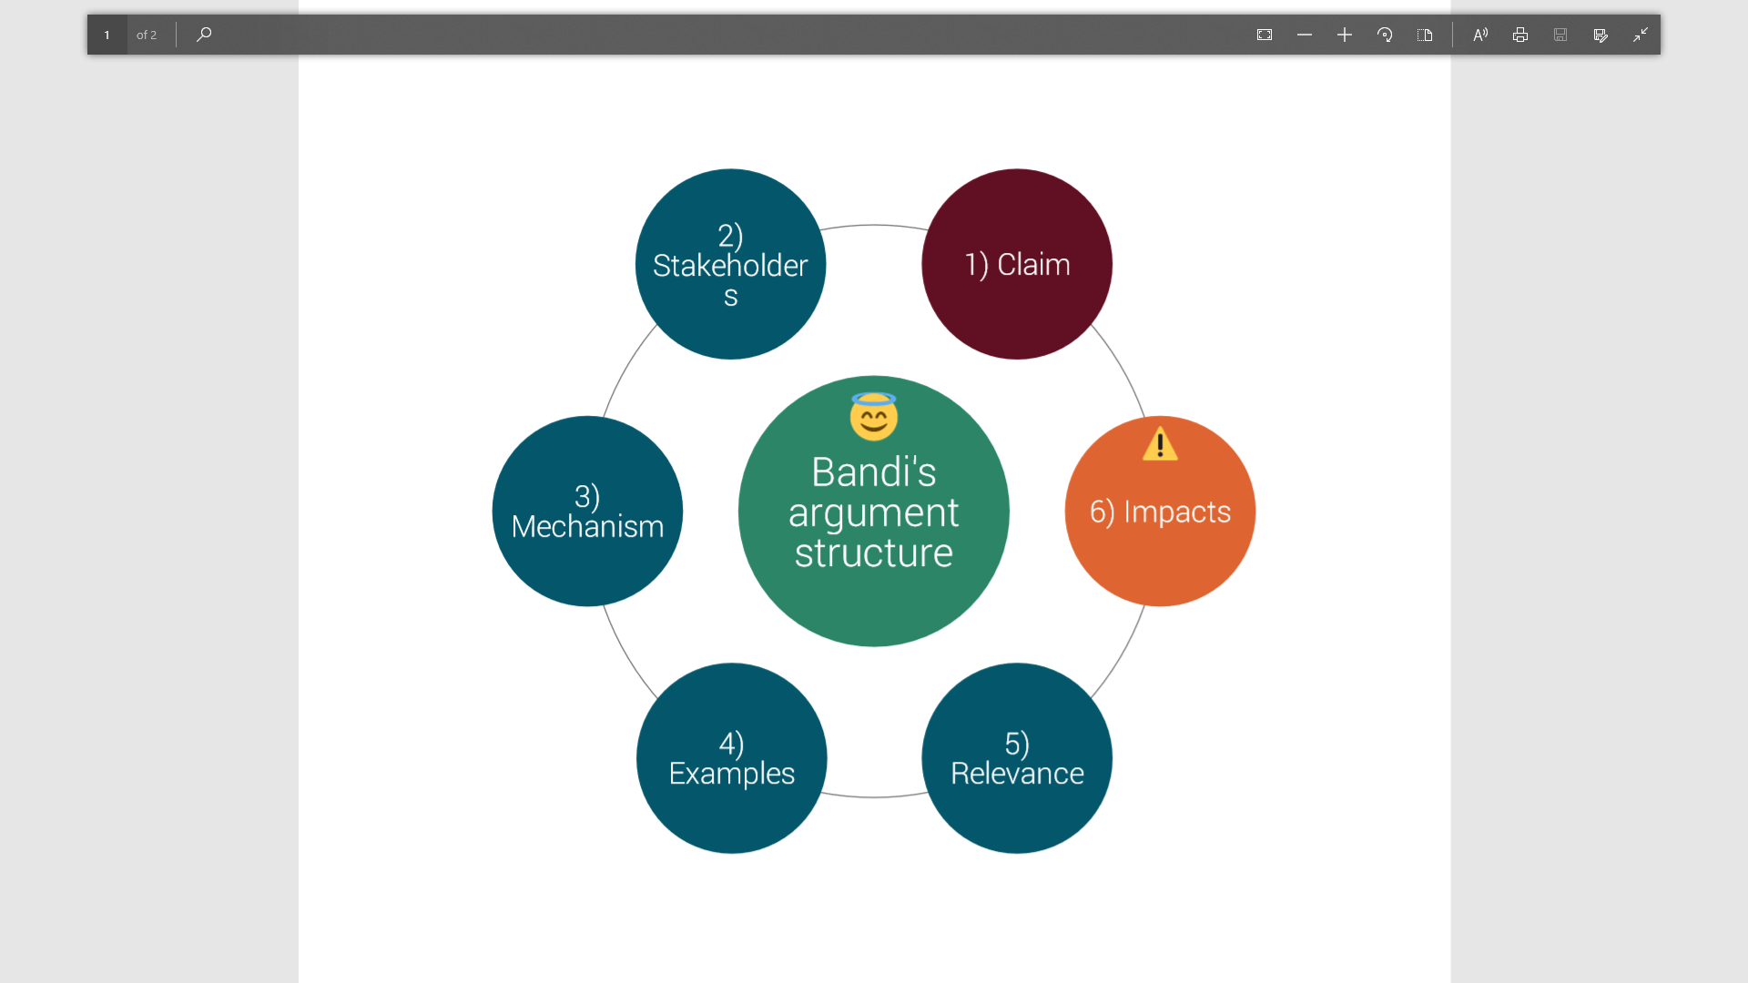

Slide 20
6) Wrap-up

Slide 21
Forms of rebutt

Slide 22
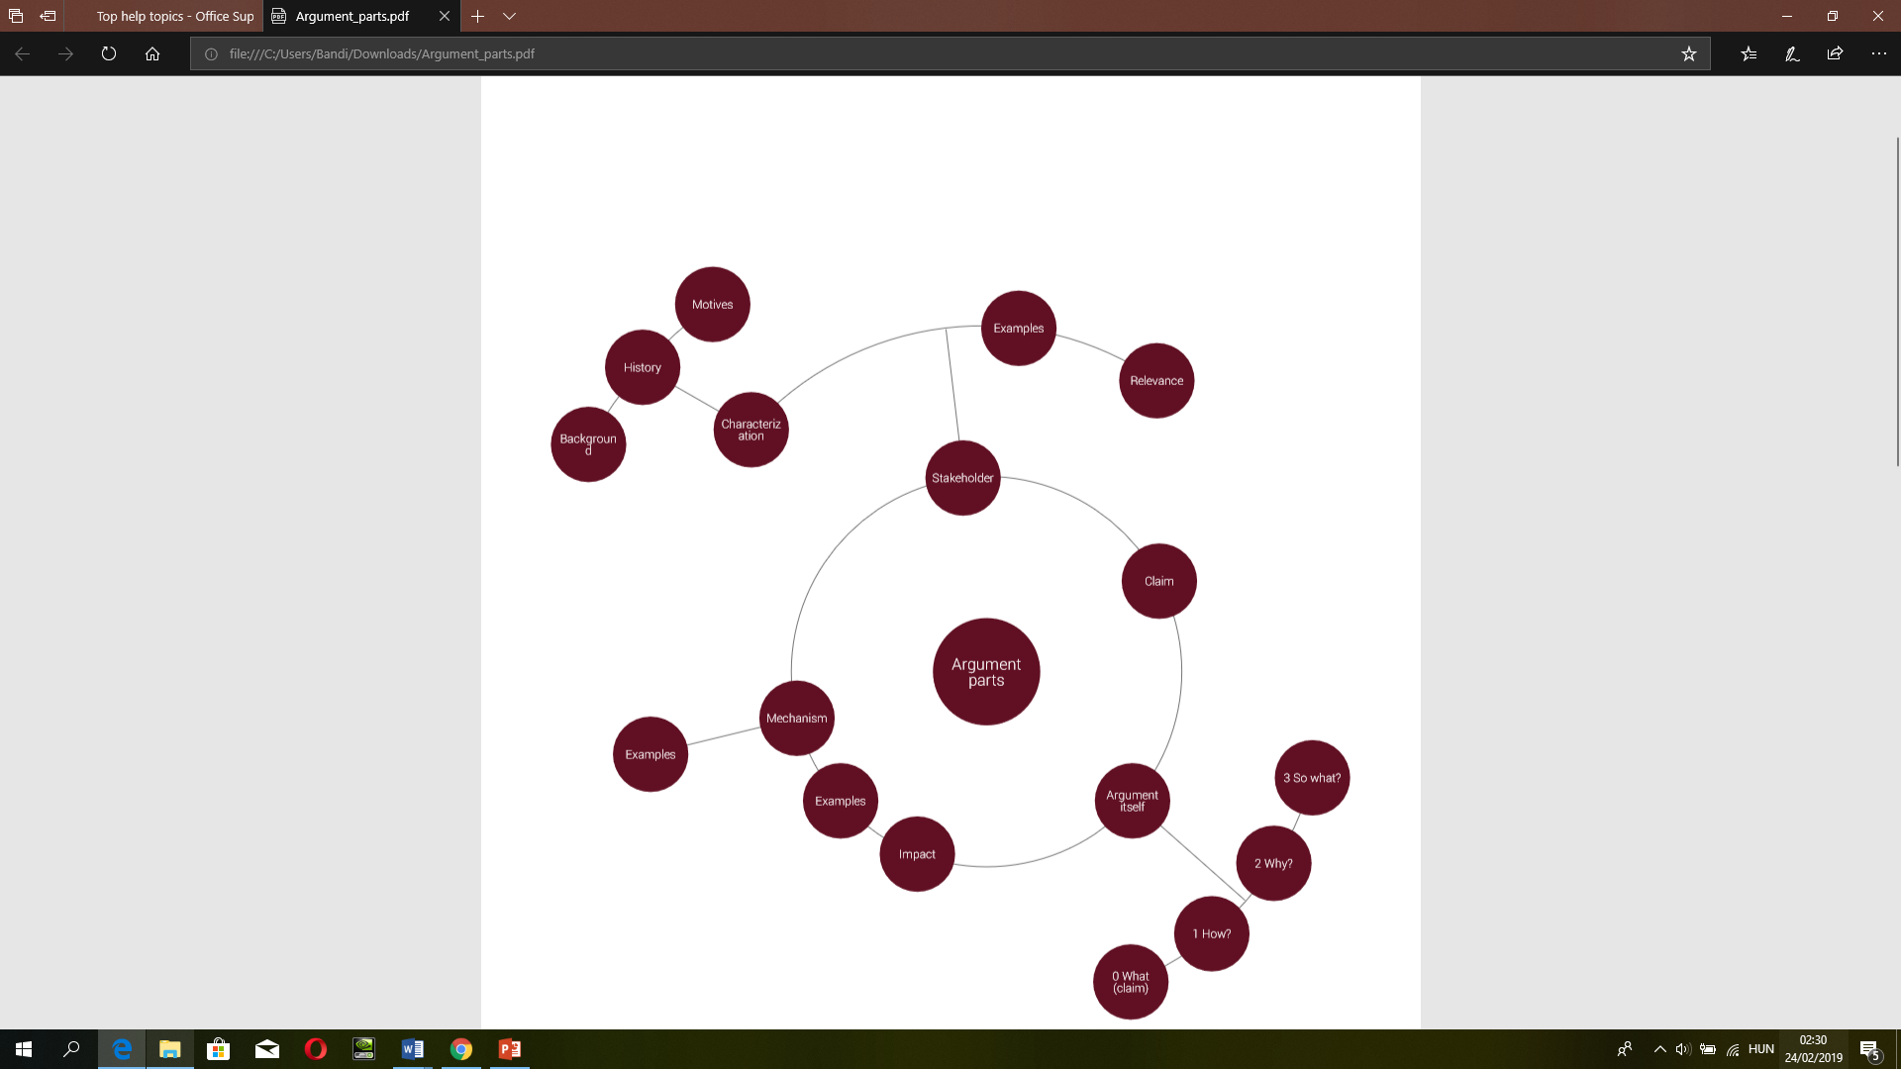

Slide 23
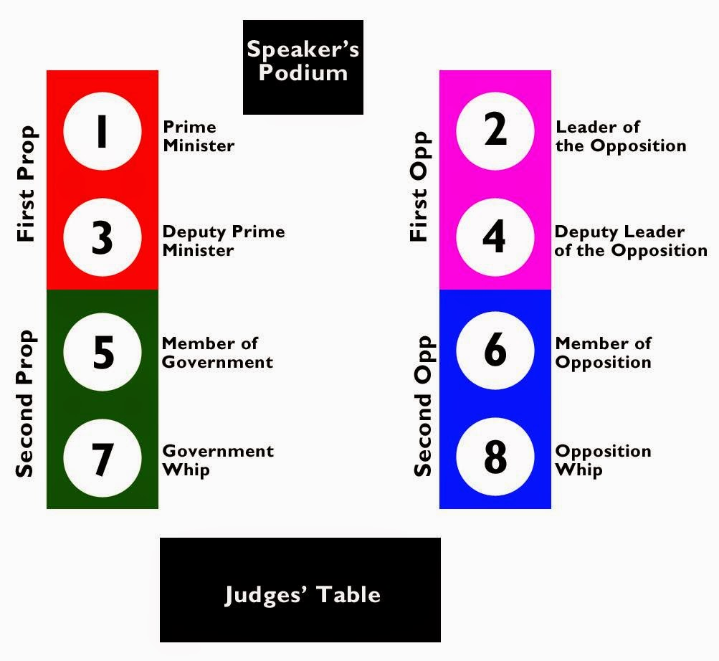
7) Motion + Debate
Please, form teams!

Slide 24
And the motion for today is...
This House Would require university graduates to move to economically deprived areas for a substantial period of time following graduation
(Cork Open, 2016, Round #2)

